Slide 1
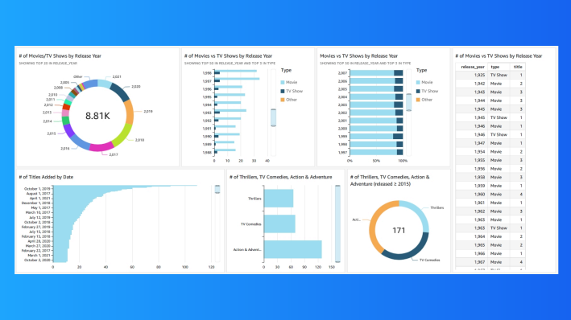
Visualize data with QuickSight

Slide 2
Introducing Today's Project!
What is Amazon QuickSight?
Amazon QuickSight is a powerful service proposed by AWS in order to analyse data and produce beautiful visualization and dashboards.
How I used Amazon QuickSight in this project?
I will use Amazon QuickSight when there is a need to analyze data, either by creating a QuickSight account and connecting it directly to a database, or fetch the data from a database and store it in a S3 bucket alongside with the manifest file.

Slide 3
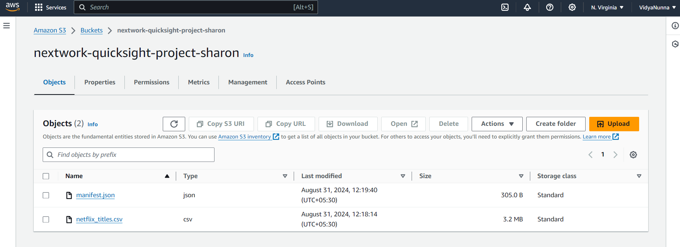
Upload project files into S3
S3 is used in this project to store two files, which are manifest.json, and netflix_titles.csv.
I edited the manifest.json file by replacing the URI information by the one in my S3 bucket. Itʼs important to edit this file because it will point to the file store into my S3 bucket.

Slide 4

Creat QuickSight account
Creating a QuickSight account cost money, but it comes with a free trial in the Entreprise tier.
Creating an account took me about a minute

Slide 5
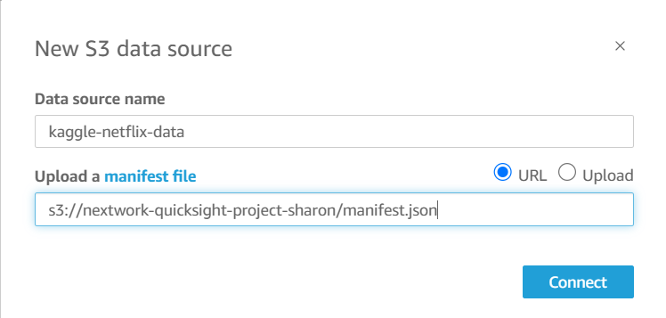
Download the Dataset
I connected the S3 bucket to QuickSight by visiting the datasets page that I located on the left Pane.
The manifest.json file was important in this step because it contains the information which will be used by QuickSight to locate the files stored in S3, and also understand how the data is organized and formated

Slide 6
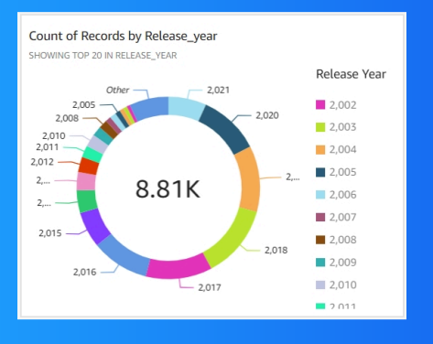
My first visualization
To create visualizations on QuickSight, I drag and drop the the field I need in the AutoGraph area, and in the Visuals Pane, I can move the field need in the correct dimension (Y Axis, Value, and Group/Color).
The chart/graph shown here is a breakdown of a count of movies and tv shows based on the released year in a donut chart format.
I created this graph by dragging and dropping the release_year field in the YAXIS, and then change the chart by clicking on "CHANGE VISUAL TYPE" in the Visuals Pane, and selecting donut chart.

Slide 7
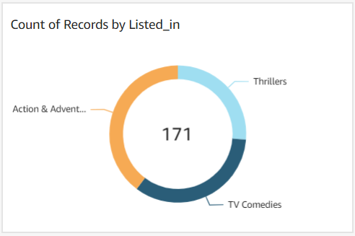
Using filters
Filters are useful for the reason that they enable us to get only a portion of data needed.
This visualization is a breakdown of a count of movies and tv shows released starting in 2015 and in the categories of "Action & Adventures", "TV Comedies", and "Thrillers". Here I added a filter by "listed_in" and "release_year".

Slide 8
Setting up a dashboard
As a finishing touch, I have rearranged my graphs and chart and also gave them a descriptive title for a very nice and clear look easy to understand.
Did you know you could export your dashboard as PDFs too? I did this by clicking on the export button located at the top right corner, and downloaded the file after it has been generated.

